Slide 1
CISC108
Introduction to Computer Science
[Instructor Name]
University of Delaware
Week 1 - Welcome

Slide 2
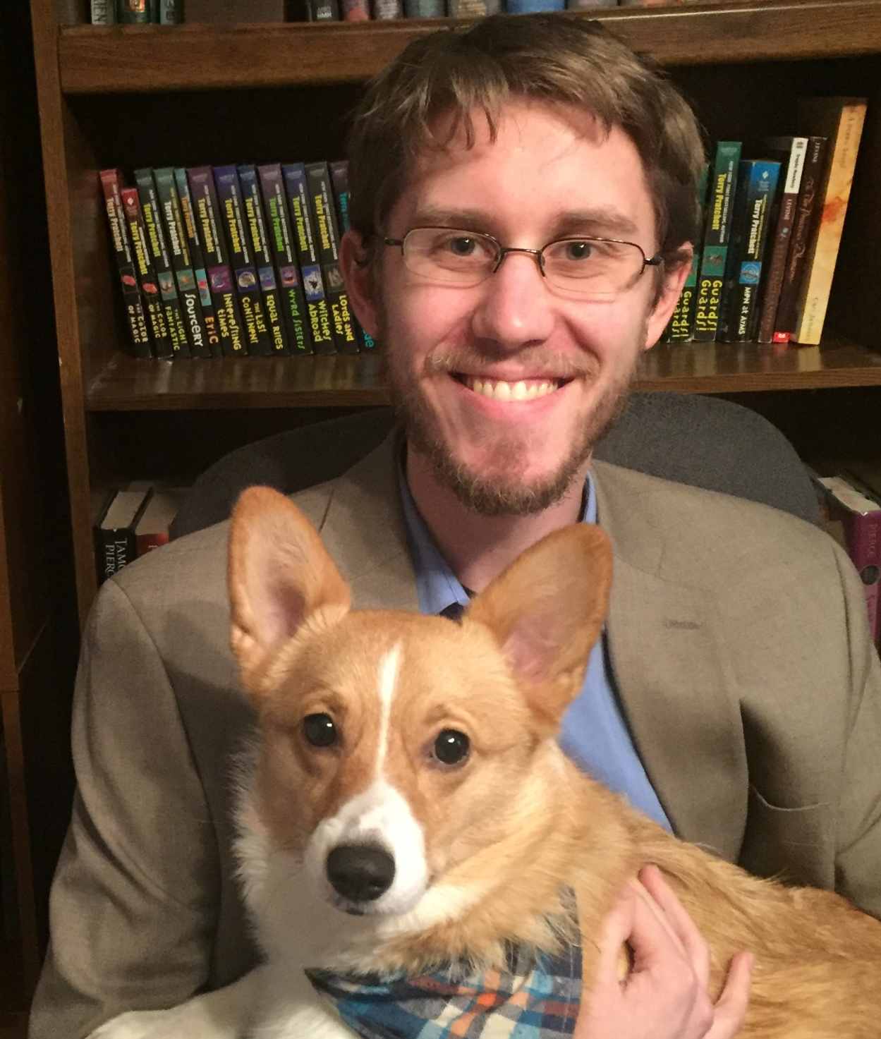
Who am I?
Dr. Bart
Instructor CISC108
Assistant Professor in Computer Science
Bachelors in CS from UD
PhD in CS from Virginia Tech
Research
Computer Science Education
Program Analysis
Data Science
Web Development
Notes:
Your information goes here instead! Spend a few minutes making sure they know who you are. Points for making yourself seem friendly and approachable!

Slide 3
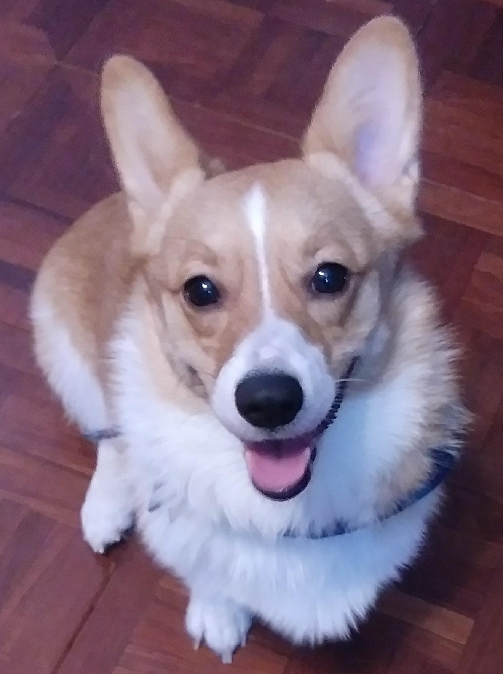
The Course Staff
Head TA
Undergraduate Teaching Assistants
Graduate Teaching Assistant
Megan Englert
Corgi Teaching Assistant
Ada
Notes:
Get headshots of all the TAs, or open the Course Staff page and show it off live.

Slide 4
Now let’s find out more about you!
Notes:
The next slide is an example of a Poll Everywhere-recommended slide. See the accompanying set of Poll Everywhere questions in the Lesson Plan. You may choose to embed them directly in the presentation, or present them from a separate window. Keep in mind that there are meant to be multiple questions!

Slide 5
Poll Everywhere Slides
What’s your major?
What year are you?
Do you have prior experience with Computer Science?
What is “Computer Science”?

Slide 6
Today’s Logistics
Next: reviewing some of the syllabus policies
Later: Lecture 1 - Introduction activity
After class: Need to complete all the Module 1 activities
Surveys 0 and 1 (15-20 minutes)
Pretest (no more than one hour)
Thonny Installation and Discord Setup (<20 minutes total)
Chapter 1 Primer, Part A, and Part B (1-4 hours)
Before next week: Read Chapter 2 Primer (<10 minutes)

Slide 7
What is "Computer Science"?
PROGRAMMING?
Notes:
This slide is animated! I asked “What is Computer Science” as a poll everywhere on the previous slide, and now we are going to talk about the answer.
I animate the slide to cross off “Computer” and explain how the field is not about computers (that’s computer engineering). Then I cross off Science and say it’s not a Science either (computers aren’t a natural phenomena). I have the word “programming” appear and then reject that one too - we aren’t really just programmers, are we? We’re more than that! This is a good time to drop the quote of “Computer Science is no more about computers than Astronomy is about Telescopes”.

Slide 8



Computer Science is…
… ABOUT SOLVING PROBLEMS!
… A LITTLE BIT ABOUT PROGRAMMING!
… A SCIENCE, A CRAFT, AN ART FORM, AND MORE…!
Notes:
So instead, this is how I describe the field. I emphasize CS as the study of solving problems, using computation.
I like to acknowledge that Programming is involved a little bit, and we do have to get good at that.
But mostly, I want to talk to them about all the different ways we can look at CS. Emphasize especially how we can use it to make art, we can use it to help study the world, how we can build things that help people. This is an opportunity for a pitch that CS is great!

Slide 9
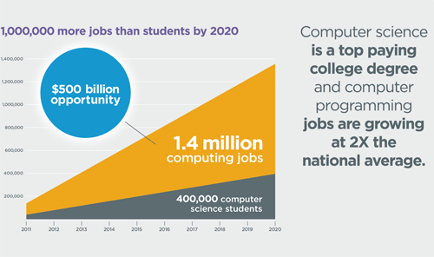
Why major in Computer Science?
Empowering
New abilities and skills
Careers
Almost guaranteed employment
Fun!
Cool stuff
Notes:
Generic information; could be updated

Slide 10



How do you succeed at this course?
Practice, practice, practice
Start early, Work often
Connect with others
Notes:
I like to mention this now, even though I don’t know that everyone’s listening by this point. I think it’s important to highlight that students will do better at this course by regularly practicing, starting early, and making it a social experience. There’s citations to back up these claims, but I think most people will find them intuitive.

Slide 11



Topics Covered
Coding fundamentals
Variables, Types
Functions
If statements
Loops
Basic data structures
Good software design practices
Testing
Commenting
Abstraction
Practice writing larger programs
Notes:
I avoid spending too much time here. Many students won’t know what this means yet, but I want to introduce what we are doing a little for those who do. The goal is not to enumerate course topics, but to give a very quick idea of what we will be doing.

Slide 12
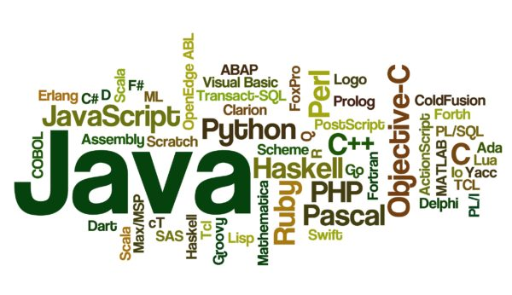

Why Python and not…?
Notes:
Highlight that there are many other languages in the world, which have their own trade-offs. Python is not the best language for every task – but it is a useful language for many kinds of problems. We aren't here to sell Python too much, but let them know that it's one of the biggest ones out there, on par with Java, C, or JavaScript.
You might skip this; in 2022 we don’t need to sell the “world’s most popular language”.

Slide 13
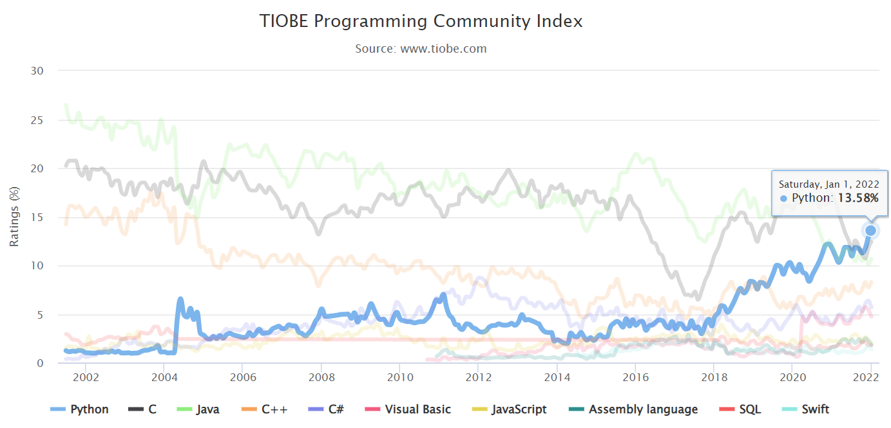
Notes:
As of 2022, Python is the most popular programming language according to the Tiobe Index, finally beating Java and C.

Slide 14
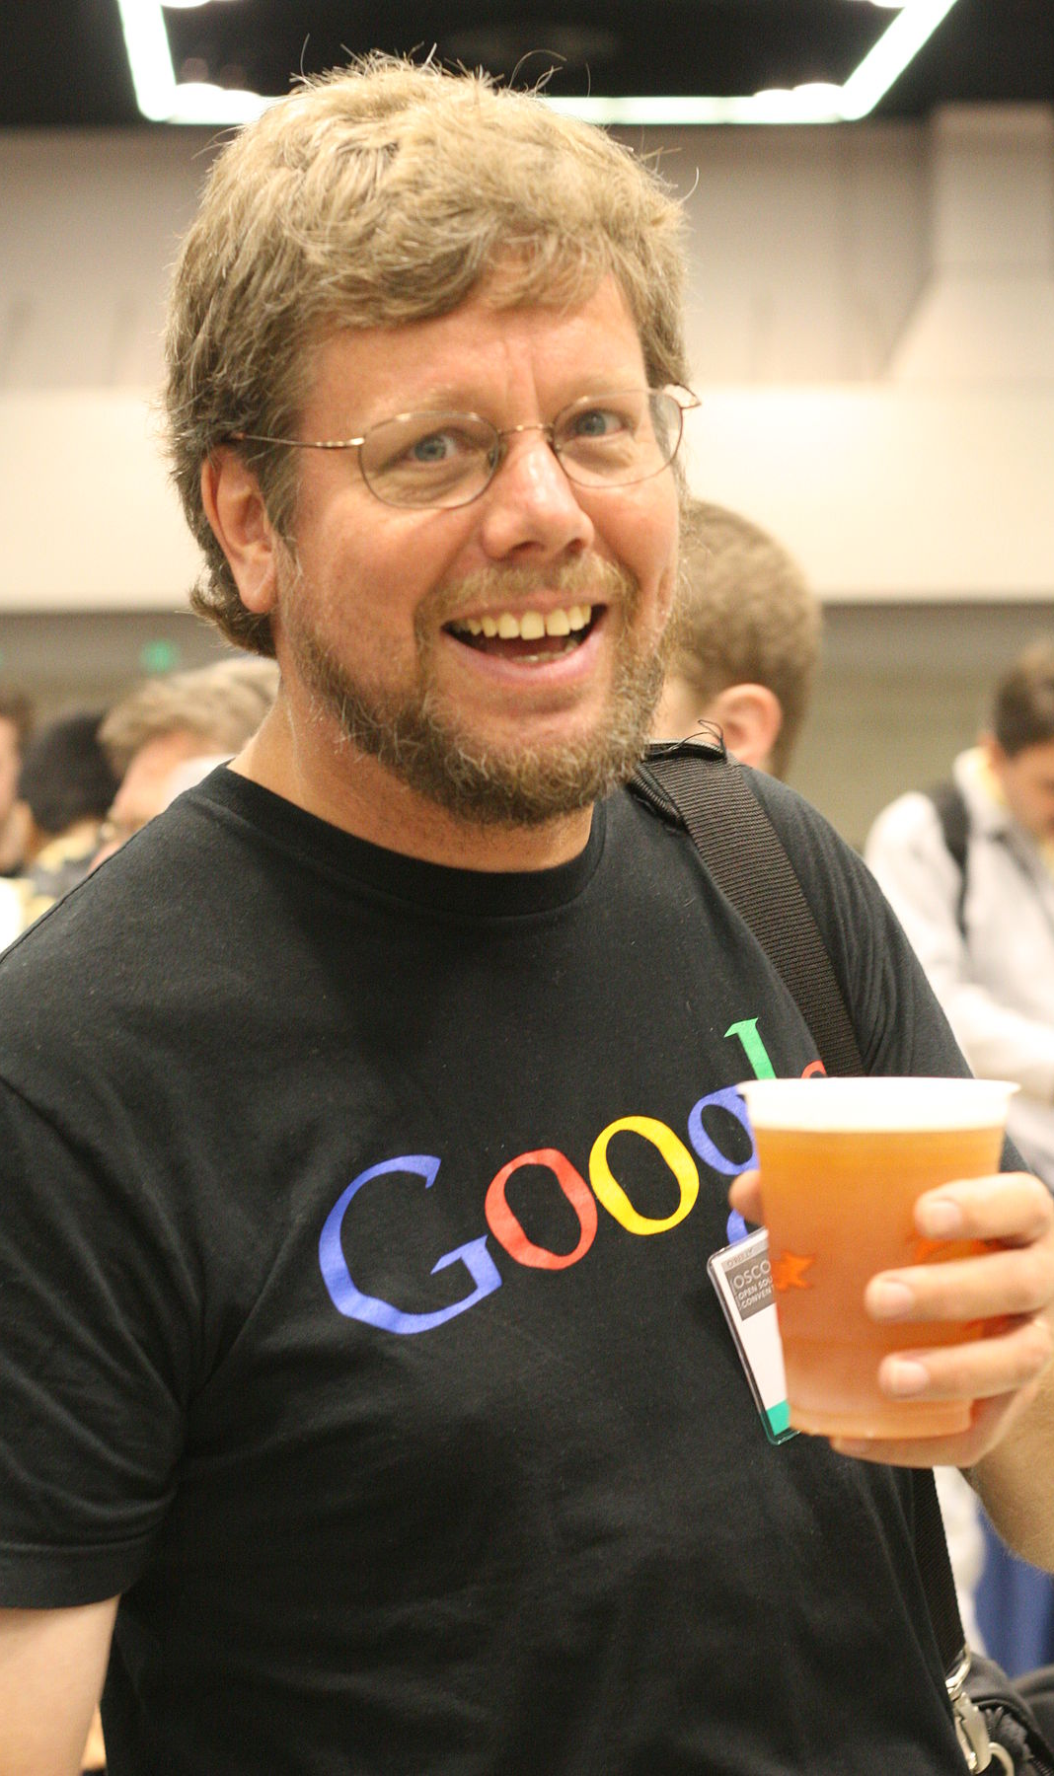
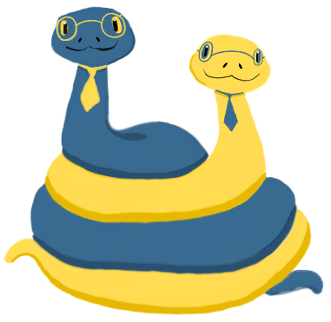

Why is it named "Python"?
Notes:
This slide is animated. I sometimes like to have a conversation with students about the name Python, since it’s amusing and paints me as more of an expert on the language. You might skip this.
Some quick history!
Python was created around 1991 (depending on when you consider its first release)
The guy in the photo is named Guido van Rossum (pronounced https://www.howtopronounce.com/guido-van-rossum/), he's the original creator of Python.
But Python is now more of a community effort than the work of one person. They have a whole council of people who are elected to make decisions.
It is not named after the snake, it's named after Monty Python's Flying Circus, a famous British comedy troupe that probably none of your students recognize.
More info: https://en.wikipedia.org/wiki/Python_(programming_language)

Slide 15
Mechanics
Notes:
Pivot now to talk about course mechanics! This is way more important. This is the “syllabus stuff”, really.

Slide 16
Course Community
Major goal: build a learning community
Some simple principles:
We all love answering questions
We help each other
We support each other
It's totally cool to not know stuff
(Longer list in syllabus)
Notes:
I like to start off with principles of being a good community. Remember, one of our biggest goals is to establish a friendly culture and atmosphere where people are comfortable asking for help from each other and us. That’s probably the best thing we can do to help their learning. This may feel silly, but establishing that you (the instructor) value these things is really important.

Slide 17
Community Places
Lecture
Lab
Discord
Emails (1-1)
…
Notes:
This slide will probably change a lot before the semester starts, but the goal is to highlight the different places we will interact with students in-person and online.

Slide 18

Collaboration Is Good!
Lectures and Labs require that you work with others
Other assignments let you work together too!
Do not just divvy up the work
Never give someone the answer
Find common times to work sitting next to each other or screen sharing on Zoom
Work on the same problems TOGETHER.
Notes:
This is contrary to how we are running policies in most of the course/sections. They shouldn’t work together on most of the assignments, at least not officially encouraged (students will do what they will when outside of our gaze).

Slide 19
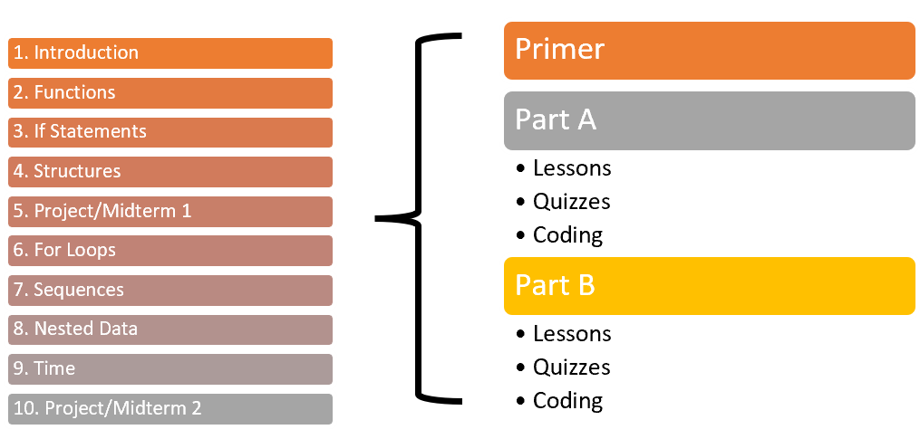
Course Structure
Every Week:
Lecture
Lab
Chapter readings
Some Weeks:
Survey
Project
Midterm
..?
Anatomy of a Chapter
15 Week Semester
Read the primer before lecture/lab each week!
Part A is due midway through the week
Part B is due by the end of the week
11-15: Final Project/Exam
Notes:
One of the most important slides! This covers the general layout of the course. Start with the left hand side (15 week semester), and describe how each week looks roughly the same. There’s a chapter reading divided into a Primer, Part A, and Part B.
They MUST read the Primer before the week starts - otherwise they are coming to lecture or lab unprepared.
You’ll need to explain your course’s particular weirdness about the First Two Weeks (see Staff canvas page with the same name for more details).
Tell them that each week they have a lecture and lab in addition to the reading.
You can mention the other types of assignments they’ll encounter are the surveys, projects, midterms, and then a few “Other” assignments that will appear periodically.

Slide 20
What to Expect in Lecture and Lab
Slides
Poll Everywhere Questions
Group Worksheets
Group Coding Activities
Why this model?
People don’t learn much from just lecture. The flipped textbook will help you with the basics, but the lecture is where you learn to be a COMPUTER SCIENTIST.

Slide 21
Your Lab Cohort
Each lab is divided into 12-student cohorts
Each cohort is led by a Teaching Assistant
You will work together and build up a community
Your TA will be checking in on your regularly and making sure you stay on track!
Your TA will also be responsible for grading lab/lecture worksheets and projects.
Notes:
This information is only for the CISC108 sections using the full Cohort model!

Slide 22

Pacing
Course is designed for those who have never programmed before
Learning to program requires time, not talent
There is a lot of material!
Expect to spend 6+ hours outside of lecture and lab each week

Slide 23
Exams
There are 3 exams this semester
Week 5, Week 10, and Week 15
Completed at the Testing Center
You schedule a 90-minute exam within a 4 day window
Assesses individual understanding
One page of handwritten notes, back and front
No internet, but you do get to work on a computer
Your final grade cannot be more than one letter grade higher than your average exam grade
You must also pass the final exam to pass the class
Notes:
Tell them that they will get access to the scheduling information soon, and they should sign up for their exam date as early as possible.

Slide 24
Communication
Discord
Discord
Office Hours
Need help with assignment
Need help with course logistics
Need in-person help on assignment or course logistics
Course Forms
Cohort TA Email
Instructor Email
Extension request, missing class, or need more help
Have a question about an assigned grade
Private issue that affects course enrollment
Notes:
PROTECT YOUR TIME AS AN INSTRUCTOR. You have a ton of students, be sure to delegate communication to the other channels where you can. If students know that they can email you about anything, they absolutely will all the time. Always force them to use the proper channel instead.

Slide 25

Attendance
Lecture and Lab are mandatory
If you miss a class, must go to office hours to makeup what you missed
Fill out the form afterwards to confirm
Notes:
VERY LIKELY TO CHANGE

Slide 26

Due Dates
Primer is due BEFORE the lecture/lab that week
Part A is due midway through the week
Part B, Lecture, and Lab are due at end of the week
Late extensions are available via a Google Form.
Notes:
VERY LIKELY TO CHANGE
All the assignments for a module open the Friday before the module starts
Those assignments will lock two weeks later
Recommend that they complete assignments during their week, rather than waiting till the deadline
Once a module locks, no submissions are possible (don't waver on this – you'll be eaten alive reopening assignments)
But on the plus side, there are no late penalties.

Slide 27
Technology
Laptop:
Required to bring to each lecture/lab
Operating System:
Mac, Windows, and even Linux is fine (but must be able to install software)
Browser:
Chrome (other browsers may not work!)

Slide 28
Emails and Announcements
I will make Announcements via Canvas at least once a week
I expect you to have seen an Announcement within 24 hours of having posted it.
Ideally, have Announcements arrive as Push Notifications or Email
Check your Email at least once a day
Some people aren't used to Email
Everyone in the professional world uses Email extensively
Notes:
VERY LIKELY TO CHANGE

Slide 29
Canvas Site
LET'S GO TAKE A LOOK
Notes:
This is a chance for a demo of the canvas site. You should walk through the following in the Student View:
The navigation tabs on the left
The Module view
What an Primer/Part A/Part B looks like
How to look at the video
How to show the transcript under the video (there's a button for Show/Hide transcript)
How to access the slides
How to access the lesson's assignments
What a quiz looks like
What a coding question looks like
What the Grades menu looks like
How to go to a submission (mention that this works even if the assignment is locked!)
How to go to an assignment for that submission
The BlockPy dashboard to see submitted assignments and the FULL textbook view
Show the syllabus page
Show the Course Staff page
Go to the Discord, show how that works

Slide 30




BlockPy
Dual block/text Python environment
Autograder
Primary Developer: Dr. Bart
Report internal errors to the Discord!
Research experiment
Notes:
BlockPy is the environment that most assignments will be submitted through. This semester, besides programming problems, it also has Readings and MQ/TF/MA quizzes. The readings have videos, downloadable PDF of slides, and the transcript below them. The quizzes can be tried multiple times, but have a cooldown between attempts.
You don’t have to write programs in BlockPy, but you will have to ultimately submit assignments through it (there’s an Upload button). The environment attempts to give you feedback when you submit, but it is not perfect. Do not be afraid to
seek help as needed. If you get any black “internal errors”, be sure to report them to Dr. Bart ASAP.
There is also a research experiment element to the course, which will be explained next week after enrollment locks down.

Slide 31
Part 2
Notes:
This is a natural breaking point in the lecture. If you have a 50-minute class, you probably want to end it before this, and will pick up somewhere in the middle of this.

Slide 32
Cheating
You are cheating if you hand in code that you didn't write
Horror stories:
Student asked their cousin for solution. It was super obvious, and they had to retake the course.
Student got solutions from someone in previous semesters. It was super obvious, and they failed the course and had to drop the major.
Student hired someone off Cheggs. It was super obvious, and they were expelled.
Student asked a classmate for the code of a project. It was super obvious, and they failed the project (and then the course).
Seriously, if you're tempted to cheat, just come talk to me instead. We'll work something out.
Notes:
VERY LIKELY TO CHANGE
They must not take code from anyone besides the course staff.
Doing so is an honor code violation, and we have ways of detecting that (e.g., MOSS).
When you get help from peers, it can only be high level conceptual help or motivational.
You are encouraged to help each other, but do not share code or look at each other's solutions.
All of this is laid out in the Cheating Collaboration Communication Page on Canvas.

Slide 33
Accommodations
University of Delaware is committed to Accessibility, and so is the course staff
Please report DSS accommodations in a timely fashion!
If you have exam accommodations, then there’s FORM you will fill out to schedule your exams.

Slide 34
Course Feedback
Anonymized Surveys roughly every month
Anonymous “Questions and Comments” Form is always open
We take this feedback very seriously, and adapt our course as needed

Slide 35
Other Forms
The forms are in the syllabus:
Form - Request Extra Help
Form - Request Assignment Extension
Form - Class Absence
Form - Exam Trouble
Form - DSS Exam Accommodations
Form - Questions and Suggestions Box

Slide 36
Consent to Research
Studying how people learn computing
Goal: assess and improve the course, not assess you
Collecting all course data, including BlockPy logs and some surveys
Later on, we will aggregate and anonymize the data, analyze, and then publish
MUST fill out the form for credit
Answer DOES NOT affect grade
Answers will not be reviewed until AFTER final grades are assigned
If you are <18, then do not consent
Notes:
This will be covered in more depth next week, but it’s good to mention now that can read and complete the Consent to Research survey whenever they want.

Slide 37
No Lab First Week
Labs will start the second week of the semester!
Notes:
VERY LIKELY TO CHANGE

Slide 38
First Big Ideas
Abstractions
Algorithms
Represent data inside of a computer based on reality by removing unimportant details
Manipulate data by giving very precise instructions

Slide 39
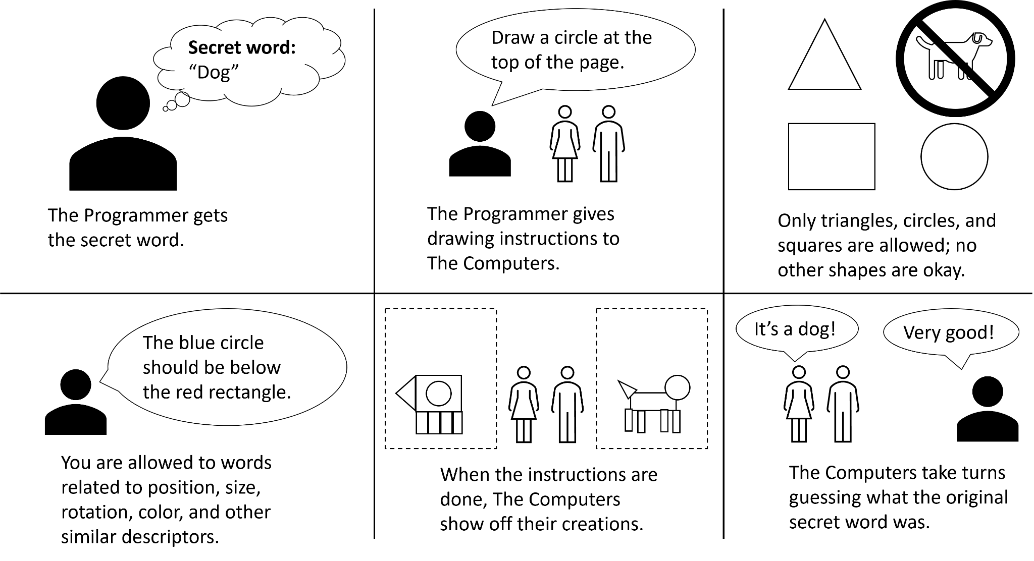
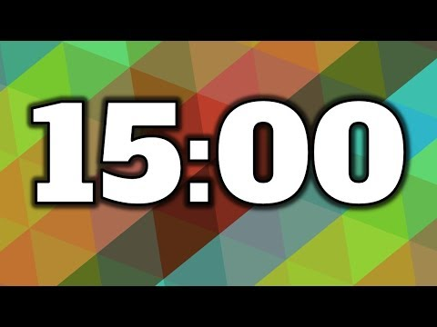
Lecture 1 - Introduction
Going to work in groups of 3
First person to open assignment:
Make a copy of the worksheet
Immediately share it with group mates
Everyone needs to put email in the top area in order to receive credit on Canvas
Only one person submits when done
We will review the answers here in class in about 15 minutes.
Start working!

Slide 40
CISC108
Have a great day!
Don’t forget:
Complete Chapter 1 by Sunday
Survey
Thonny Installation
Discord Setup
Pretest
Chapter 1 Primer
Chapter 1.A
Chapter 1.B
Complete Chapter 2’s Primer before lab/lecture next week!
See ya!

